Slide 1

Facial Detection And Recognition
Unlocking the Power of Facial Recognition Technology

Slide 2
Introduction
Face detection
Identifying human faces in images or video.
Essential for security, image editing, and social media.
Algorithms analyze visual data to locate faces automatically.
Face Recognition
Identifies a person from a database (one-to-many comparison, e.g., surveillance systems).

Slide 3
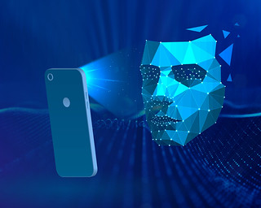
Face Detection
Face detection involves identifying human faces in images or videos.
Techniques include Viola-Jones algorithm, Histogram of Oriented Gradients.

Slide 4

Face Recognition
Face recognition identifies individuals by their unique facial features, matching detected faces with known faces in a database. It goes beyond face detection, which simply locates faces in images or videos.
Techniques include deep learning (CNNs), Eigen faces (PCA-based), and Local Binary Patterns (LBP) for feature extraction.
In short, face recognition identifies individuals, while face detection locates faces, using techniques like deep learning, Eigen faces, and Local Binary Patterns.

Slide 5
Advantages
Improved Security and Surveillance:
Identification: Accurate face recognition enhances security for access control and law enforcement.
Real-Time Alerts: Surveillance cameras can trigger alerts for unauthorized individuals.
Crime Prevention: Tracking known criminals helps prevent crimes.
Enhanced User Experience:
Photo Organization: Automatic grouping of photos based on recognized faces simplifies management.
Social Media Tagging: Face recognition suggests tags for friends and family.
Personalization: Content tailored to user preferences based on facial features.

Slide 6
Negative Impacts
Ethical Concerns:
Privacy: Balancing privacy rights with data utilization is crucial.
Individual Wishes vs. Regulations: Conflicting preferences create ethical dilemmas.
Technical Challenges:
Accuracy: Ensuring precise data handling.
Legal and Regulatory Issues:
Data Protection Laws: Compliance across diverse jurisdictions.
External Data Sources: Managing privacy and regulations .

Slide 7
Applications
Security and Surveillance: Used for access control in buildings and devices, as well as by law enforcement for identifying suspects and enhancing public safety.
Marketing and Customer Service: Enables personalized advertisements based on customer demographics and behavior, and enhances customer service through recognition for tailored experiences and VIP treatment.

Slide 8
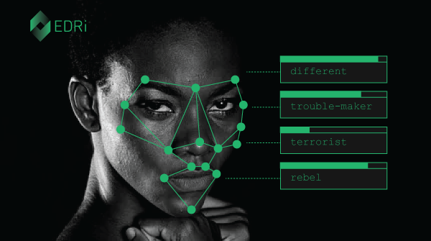
Conclusion
Future Prospects:
Improved Accuracy: Advances in deep learning and neural networks will enhance accuracy.
Real-Time Processing: Faster algorithms and hardware will enable real-time face analysis.
Privacy Considerations: Balancing security with privacy rights will be crucial.
Multimodal Integration: Combining face recognition with other biometrics (voice, iris) for robust identification.
Significance in Society:
Security: Preventing unauthorized access, identifying criminals, and securing public spaces.
Personalization: Customized experiences in retail, entertainment, and social media.
Healthcare: Diagnosing medical conditions (e.g., genetic disorders) through facial features.
Ethical Concerns: Addressing biases, consent, and potential misuse.
This Photo by Unknown author is licensed under CC BY-SA.

